Slide 1
Unguided Media
Lecture 4

Slide 2
UnGuided Media
Unguided media transport electromagnetic waves without using a physical conductor.
This type of communication is often referred to as wireless communication.
Radio Waves
Microwaves
Infrared

Slide 3
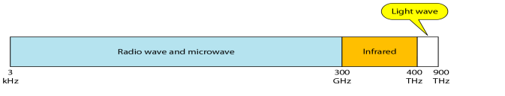
Unguided Media

Slide 4
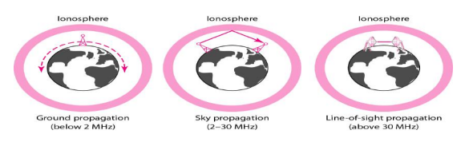
Unguided Media
Unguided signals can travel from the source to destination in several ways: ground propagation, sky propagation, and line-of-sight propagation, as shown in Figure

Slide 5
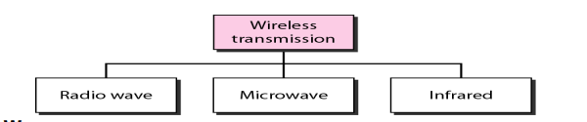
Modes of Transmission

Slide 6
RadioWaves
Electromagnetic waves ranging in frequencies between 3 kHz and 1 GHz are normally called radio waves.
Radio waves are omni directional. When an antenna transmits radio waves, they are propagated in all directions.
This means that the sending and receiving antennas do not have to be aligned. A sending antenna sends waves that can be received by any receiving antenna.
The omni directional property has a disadvantage, too. The radio waves transmitted by one antenna are susceptible to interference by another antenna that may send signals using the same frequency or band.

Slide 7
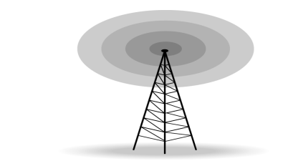
Omni directional Antenna
Radio waves use omnidirectional antennas that send out signals in all directions. Based on the wavelength, strength, and the purpose of transmission, we can have several types of antennas. Figure shows an omnidirectional antenna.

Slide 8
Omni directional Antenna
Applications
The Omni directional characteristics of radio waves make them useful for multicasting, in which there is one sender but many receivers. AM and FM radio, television, maritime radio, cordless phones, and paging are examples of multicasting.

Slide 9
Microwaves
Electromagnetic waves having frequencies between 1 and 300 GHz are called microwaves. Microwaves are unidirectional.
The sending and receiving antennas need to be aligned. The unidirectional property has an obvious advantage.
A pair of antennas can be aligned without interfering with another pair of aligned antennas

Slide 10
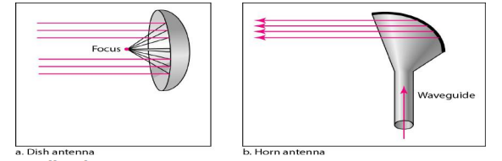
Unidirectional Antenna
Microwaves need unidirectional antennas that send out signals in one direction. Two types of antennas are used for microwave communications: the parabolic dish and the horn
Applications: Microwaves are used for unicast communication such as cellular telephones, satellite networks, and wireless LANs

Slide 11
Infrared
Infrared waves, with frequencies from 300 GHz to 400 THz (wavelengths from 1 mm to 770 nm), can be used for short-range communication. Infrared waves, having high frequencies, cannot penetrate walls.
This advantageous characteristic prevents interference between one system and another; a shortrange communication system in one room cannot be affected by another system in the next room.
When we use our infrared remote control, we do not interfere with the use of the remote by our neighbors. Infrared signals useless for long-range communication. In addition, we cannot use infrared waves outside a building because the sun's rays contain infrared waves that can interfere with the communication.

Slide 12
Infrared
Applications:
Infrared signals can be used for short-range communication in a closed area using line-of-sight propagation.

